Slide 1
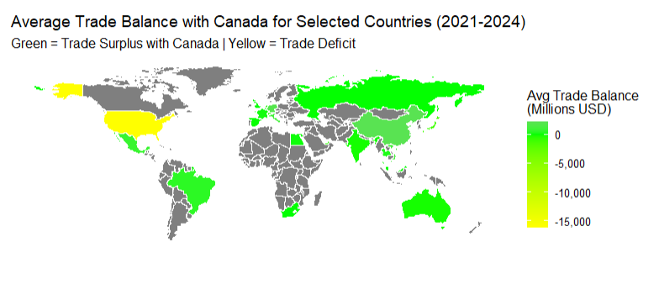
STAT 442 Exploration on Canada’s Global Trade Data
Chaozhong Wang
April 2025

Slide 2
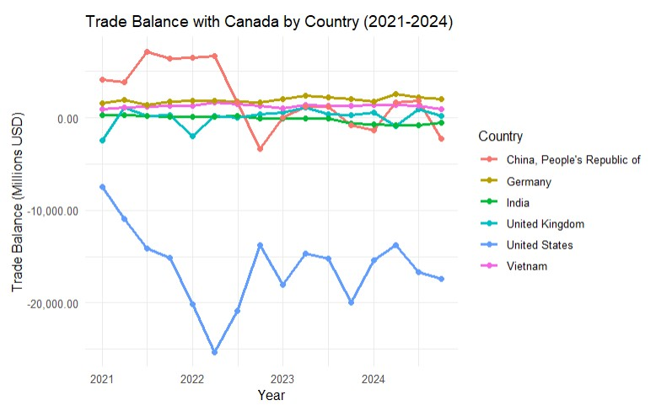
Key Trade Patterns with Canada (2021-2024)
Canada's trade relationships show striking imbalances, with the United States dominating deficits and China leading surpluses. The data reveals two distinct tiers:
Extreme volatility: US-China trade swings exceed $10B quarterly
Stable partners: Vietnam/Germany maintain consistent surpluses

Slide 3
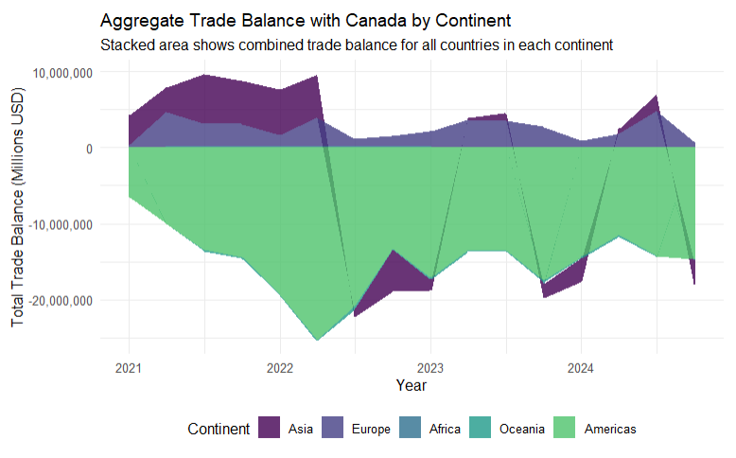
Continental Trade Dynamics
A continent-level view uncovers structural patterns:
Asia's manufacturing dominance: $4.3B avg surplus led by China, Vietnam, and Thailand
Europe's split profile: Germany/Italy offset UK/Switzerland deficits
Americas' imbalance: -$15.6B deficit driven by US trade
Emerging gaps: Africa/Oceania show minimal but growing engagement

Slide 4
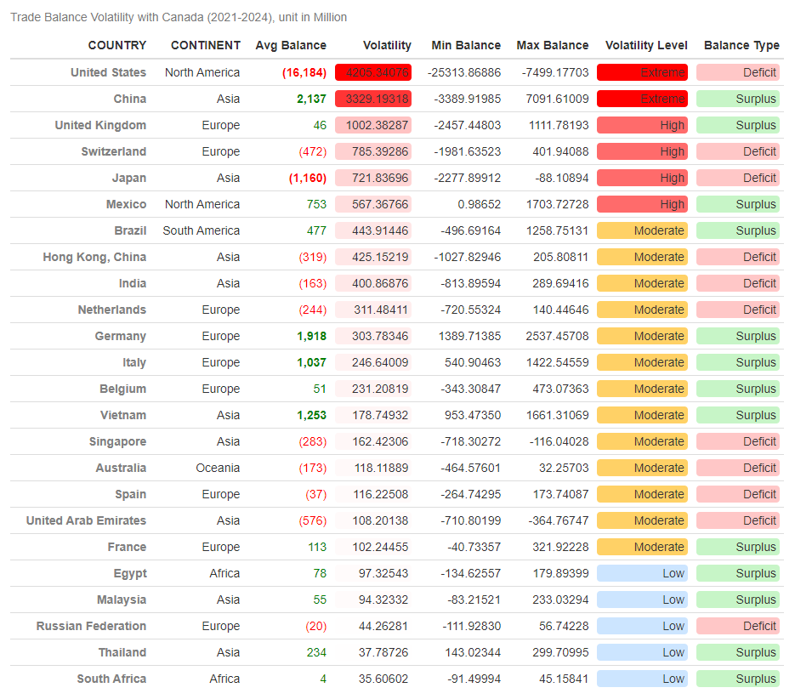
Volatility Table
Four countries account for 68% of all trade volatility.
United States (SD: $2.1B) Chronic deficits worsened post-2022
China (SD: 3.3B)
Swung from +7.1B (2021-Q3) to -$3.4B (2022-Q4)

